Slide 1

www.StampOutFraud.com
First Sergeant Peter W. Lazear
Statewide Program Coordinator

Slide 2
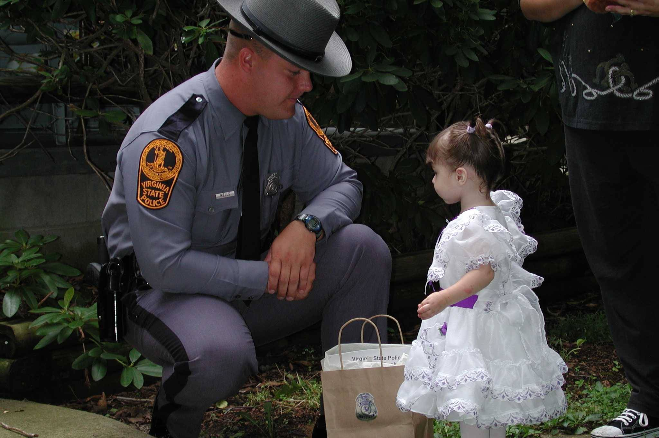
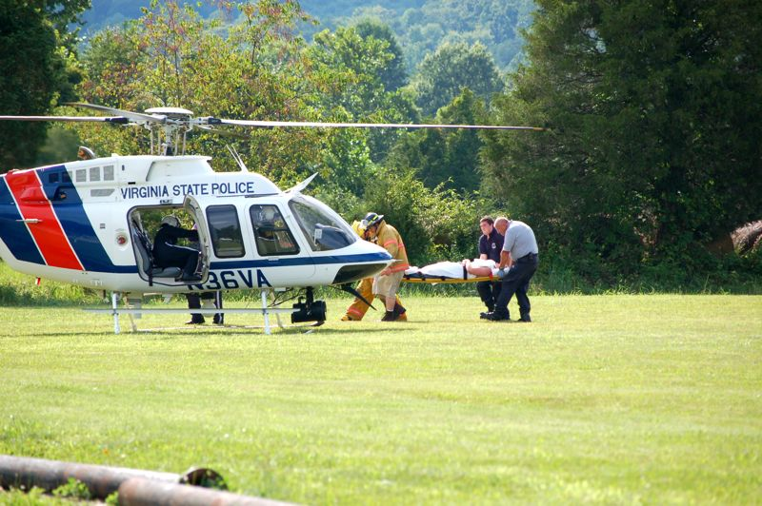
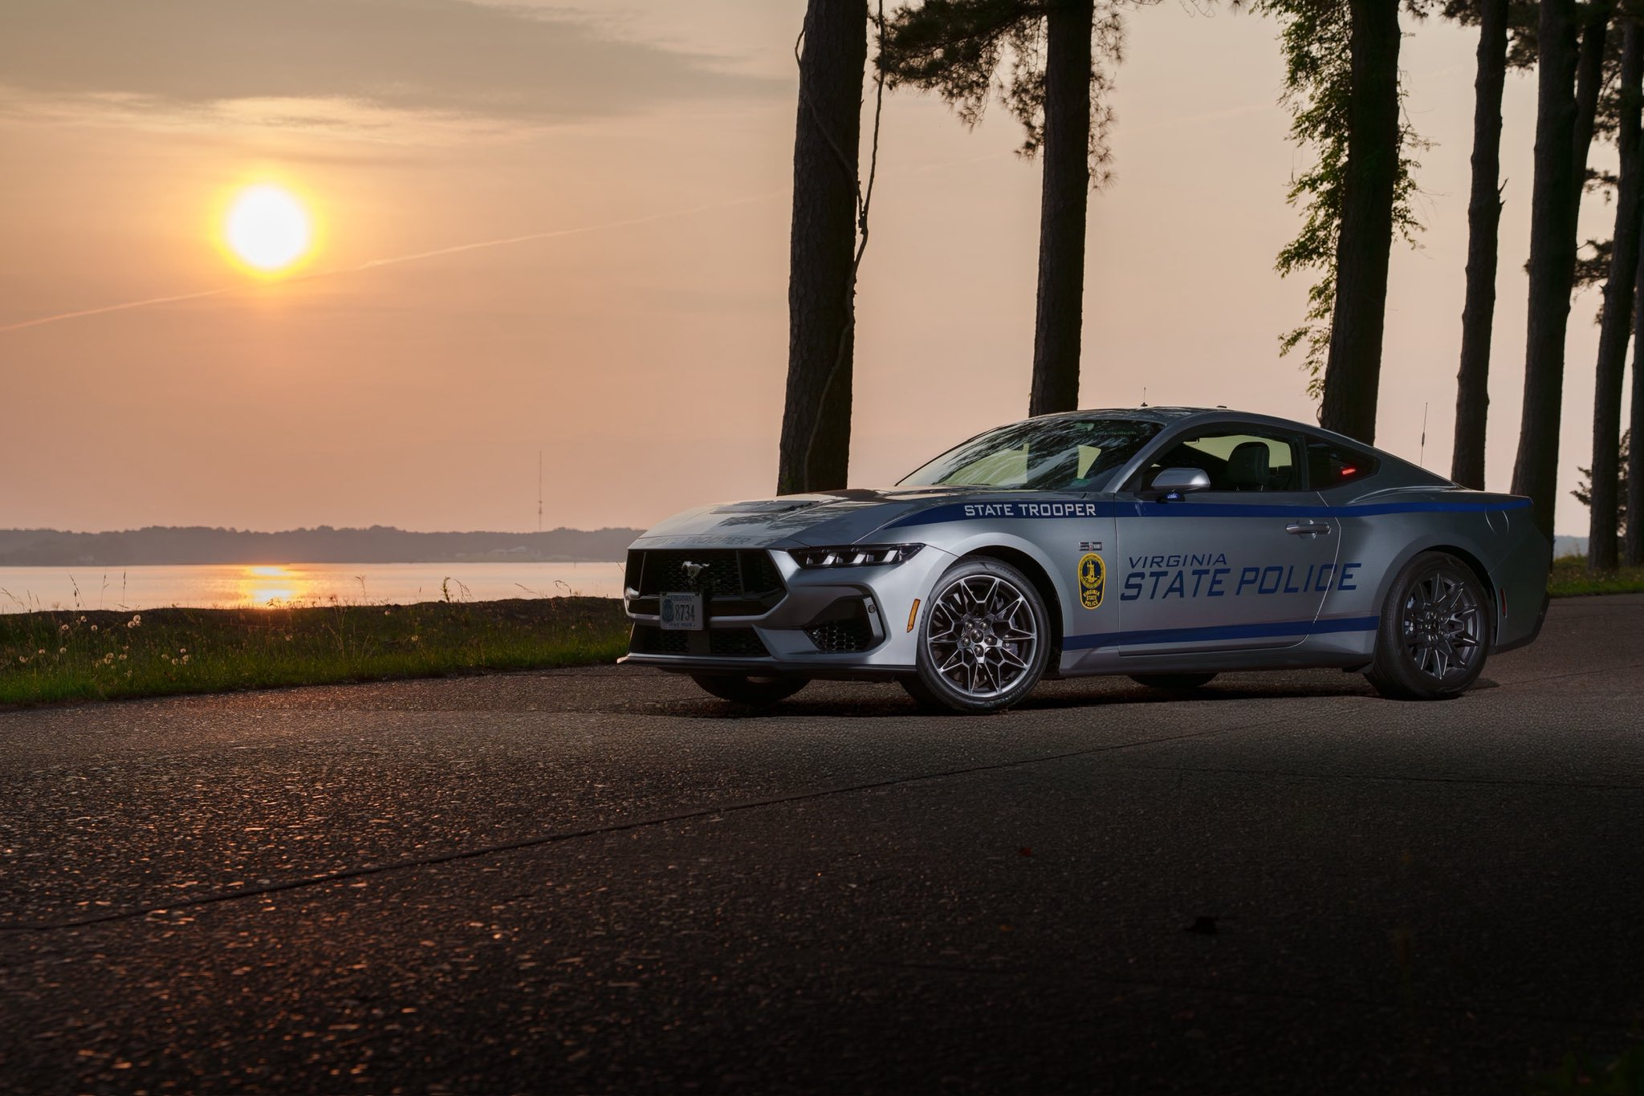
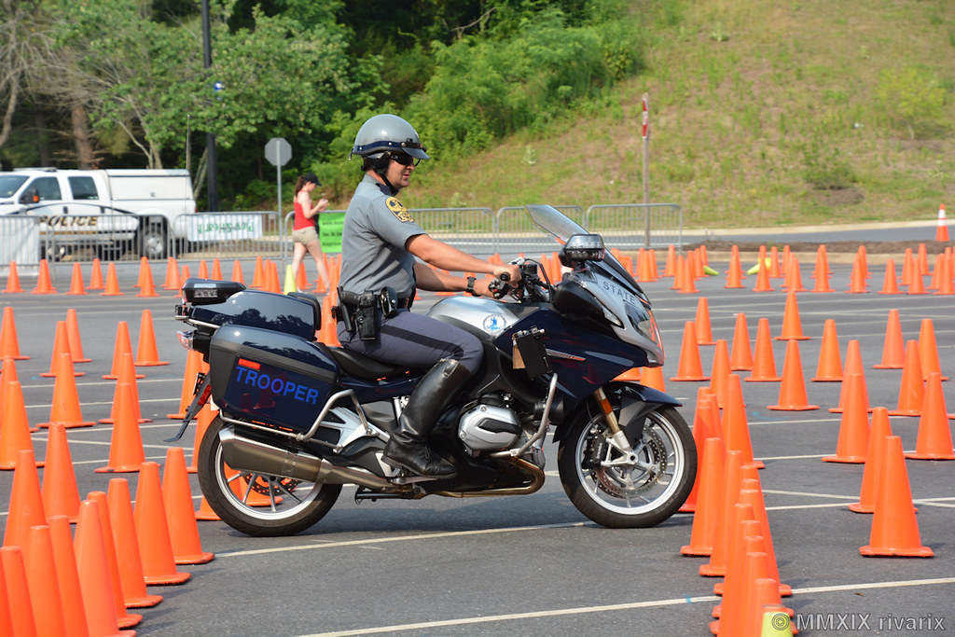
Many Faces of the State Police
Notes:
As a resident of Virginia, you are likely familiar with this aspect of the Virginia State Police. However, VSP investigates all criminal, traffic, and game violations.

Slide 3
ORGANIZATIONAL CHART
SUPERINTENDENT
BUREAU OF
CRIMINAL
INVESTIGATION
BUREAU OF
FIELD OPERATIONS
BUREAU OF
ADMINISTRATIVE AND
SUPPORT SERVICES
BUREAU OF
STRATEGIC
GOVERNANCE

Slide 4
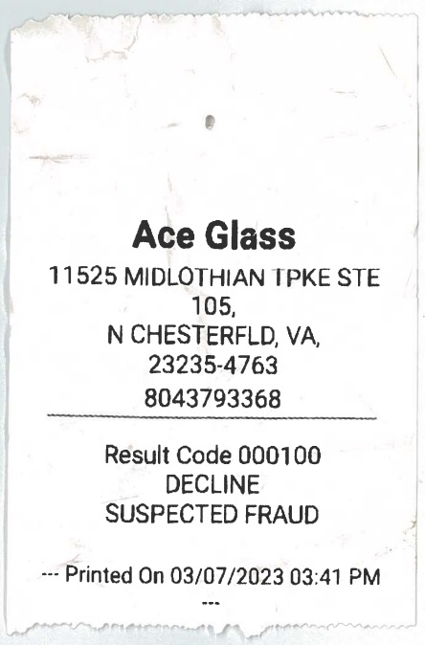
FIRST-HAND EXPERIENCE

Slide 5
WHAT IS INSURANCE FRAUD?
Insurance fraud occurs when a person or persons make money or attempt to make money from insurance transactions through deception, lying, cheating or stealing for profit.

Slide 6
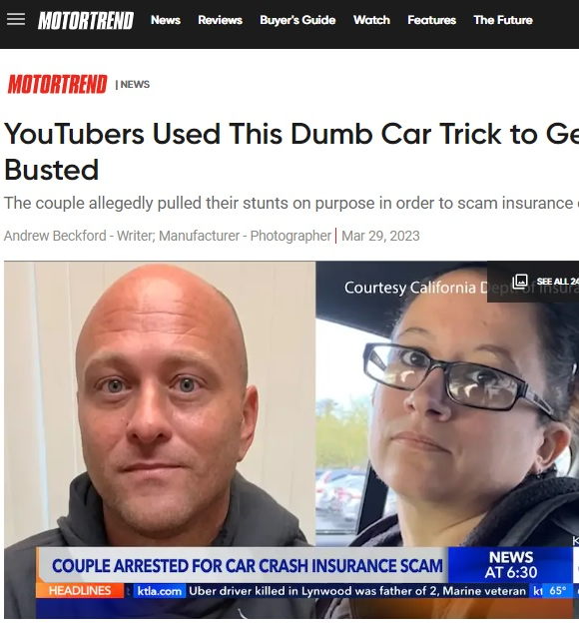
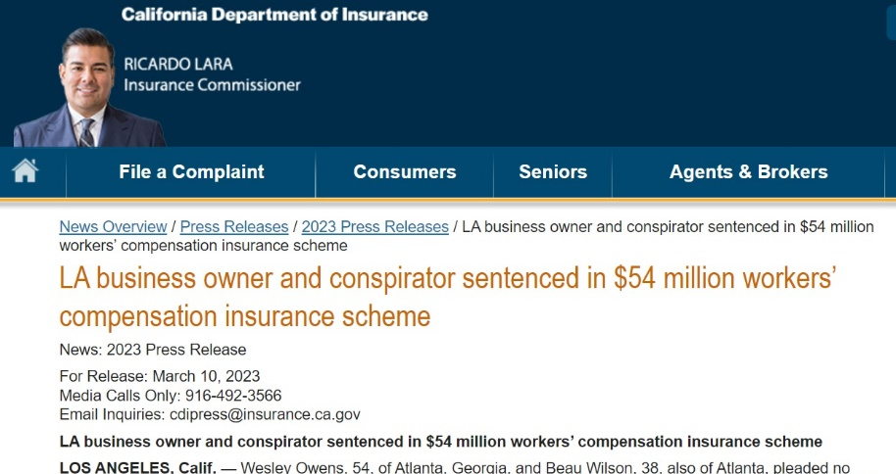
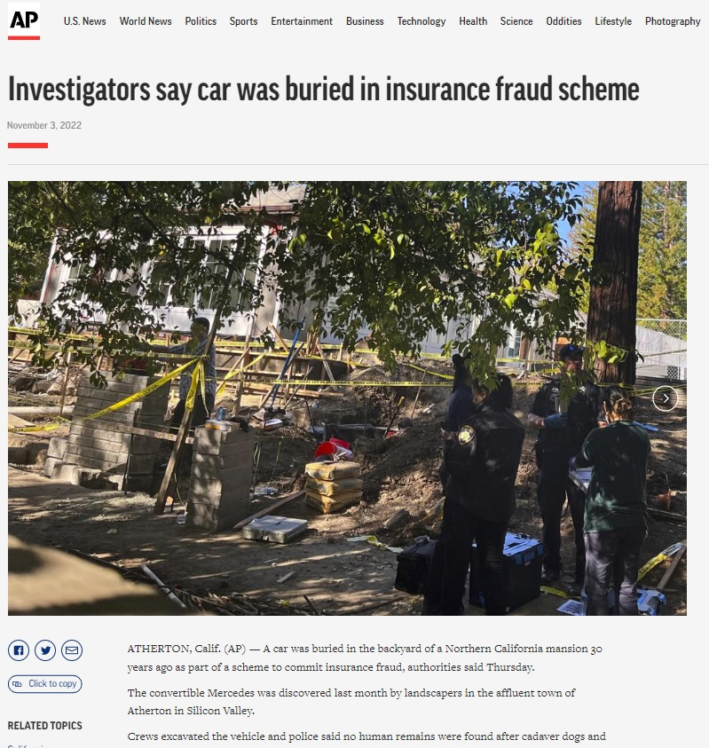
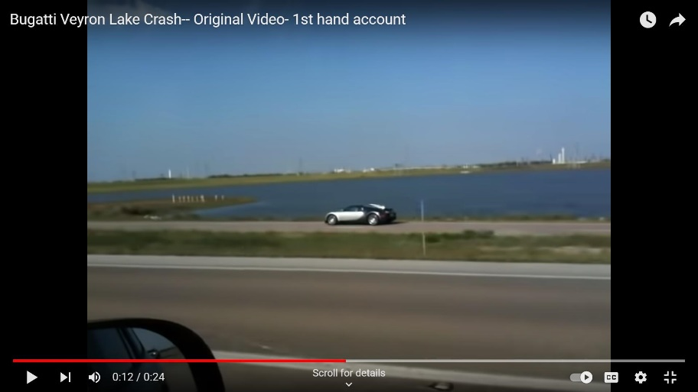
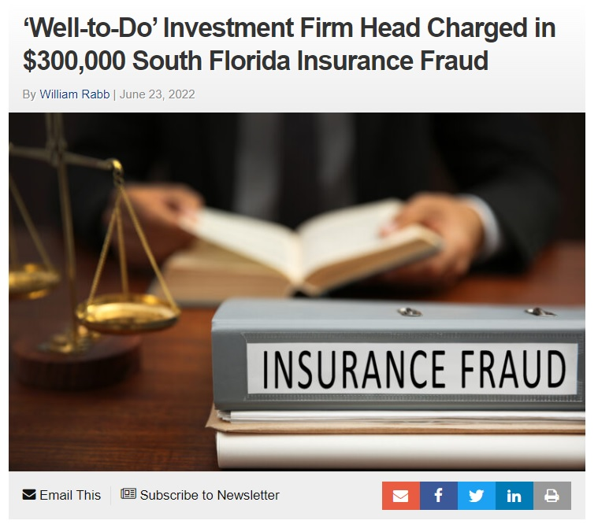
INSURANCE FRAUD IN THE NEWS

Slide 7
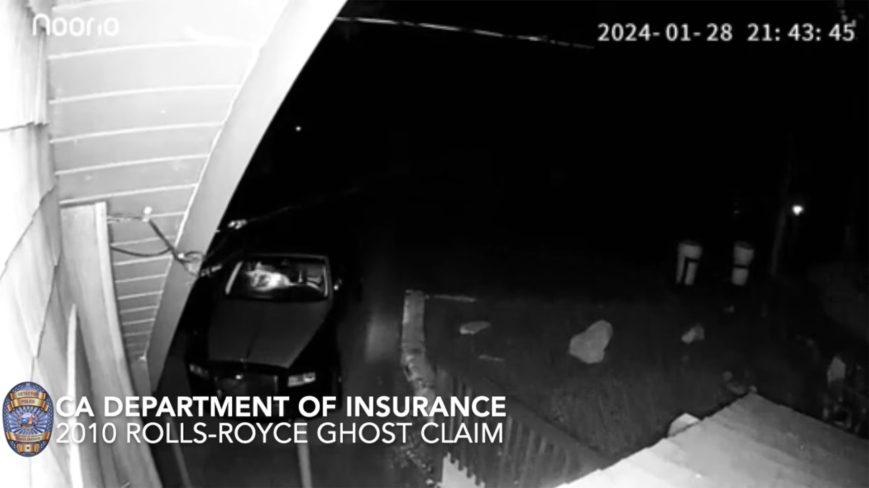
INSURANCE FRAUD IN THE NEWS
Notes:
2010 Rolls Royce Ghost
California – Operation Bear Claw
Two other claims for Mercedes cars
$141,839 in fraud

Slide 8
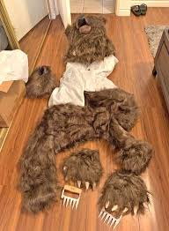
INSURANCE FRAUD IN THE NEWS

Slide 9
BACKGROUND
VA Code Section 52-37
Established the Insurance Fraud Investigation Unit in 1999
Under the Department of State Police

Slide 10
ABOUT US
First Sergeant
Intelligence Analyst
Program Support Technician

Slide 11
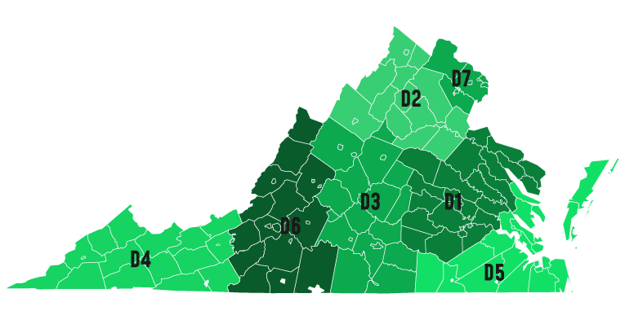
FIELD INVESTIGATORS
21

Slide 12
FUNDING SOURCE
VA Code Section 38.2-415 denotes that each licensed insurer in the Commonwealth shall pay an assessment in an amount equal to 0.05 of one percent of the direct gross premium income during the preceding calendar year into the Insurance Fraud Fund.

Slide 13
FUNDING SOURCE (continued…)
2,626 Licensed Insurance Carriers
$18,615,014,000
Direct gross premium income during the preceding calendar year

Slide 14
FUNDING SOURCE (continued…)
0.05% Assessment =
$9,307,507
INSURANCE FRAUD FUND

Slide 15
IS INSURANCE FRAUD A CRIME?
The Problem We Face
Virginia is now the only state that does not have a specific statute for prosecuting insurance fraud
VA Code Section 18.2-178
Obtaining money by false pretense
Venue may be where the act was performed or where the suspect resided at the time of the offense
Class 4 Felony:
Imprisonment for not less than 2 years nor more than 10 years
Fine of not more than $100,000
Attempting to obtain money by false pretense is a Class 6 Felony
(1-5 years in prison + up to $2,500 fine)
Notes:
*Oregon passed new insurance fraud legislation in 2024, making Virginia the last state without a specific insurance fraud law.

Slide 16
LEGISLATION - HB2095
2025 Session of the VA General Assembly
A bill to amend the Code of Virginia by adding in Article 7 of Chapter 6 of Title 18.2 a section numbered
18.2-213.3 relating to fraudulent insurance acts; penalty.

Slide 17
WHAT TO LOOK FOR
Multiple, similar claims
Changing story or reluctance to cooperate
Exaggerated repair or tow costs
Injuries inconsistent with event
No witnesses, photos, or other corroborating evidence
Recent policy or coverage changes
Receipts look fake (AI?)

Slide 18
WHY REPORT INSURANCE FRAUD?
VA Code § 52-40. Duties of insurers, their employees, and insurance professionals.
A. If any insurer, any employee thereof, or any insurance professional has knowledge of, or has reason to believe that a violation of § 18.2-178 will be, is being, or has been committed, that person shall furnish and disclose any information in his possession concerning the fraudulent act to the Department, subject to any legal privilege protecting such information.

Slide 19
HOW TO…
Report Suspected Insurance Fraud

Slide 20
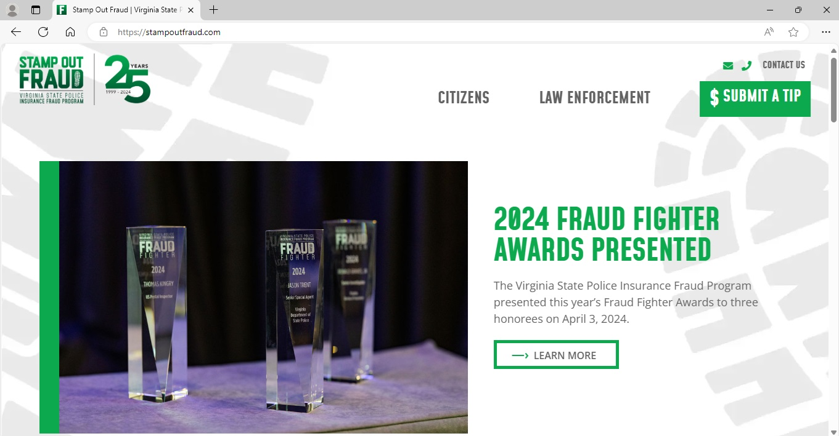
StampOutFraud.com

Slide 21
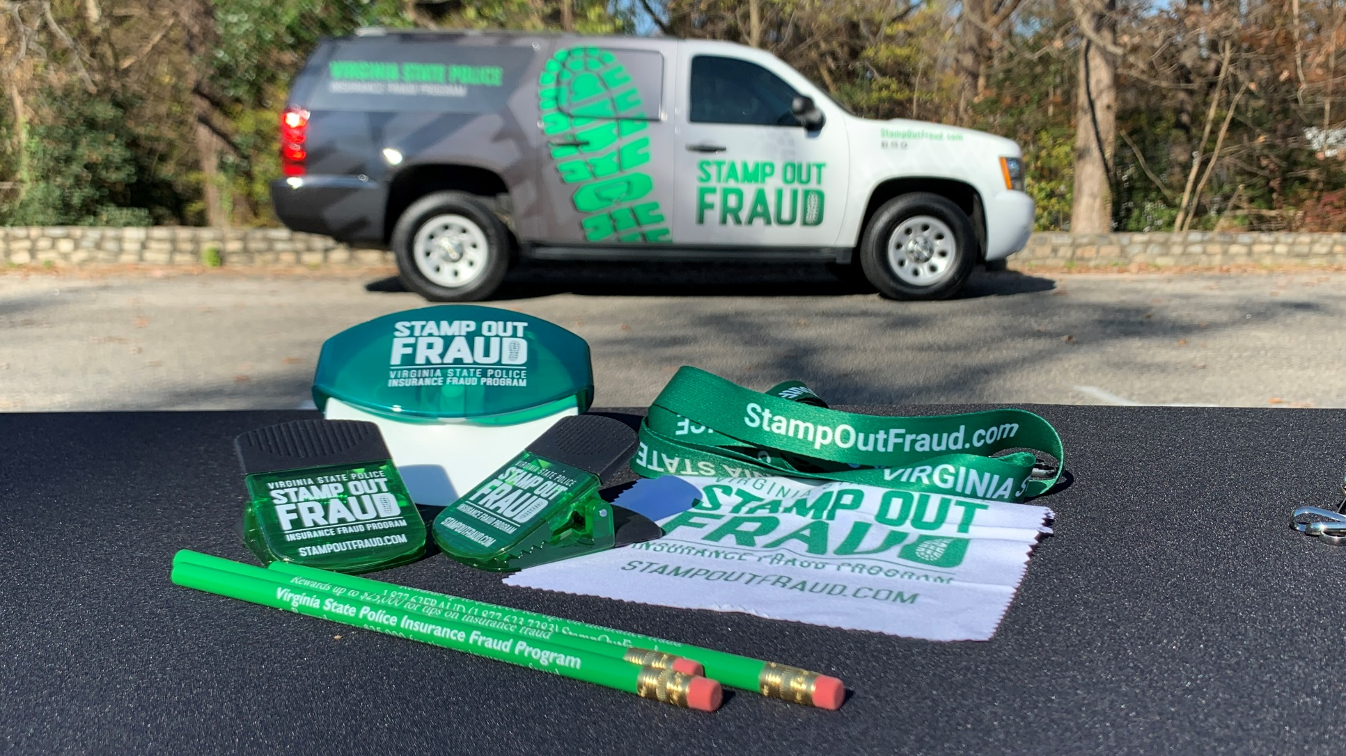
CASES RECEIVED
At least
2,500
per year

Slide 22
INSURANCE FRAUD STATS - VIRGINIA
2,112
Referrals Received
49% increase from 2023
56
Arrests
5% increase from 2023
1,490
Referrals Declined
71% declination rate
24
Cases Brought to Prosecution
4% decrease from 2023
335
Investigations Initiated
12% decrease from 2023
28
Convictions
35% decrease from 2023
Source: IFP 2024 Annual Report

Slide 23
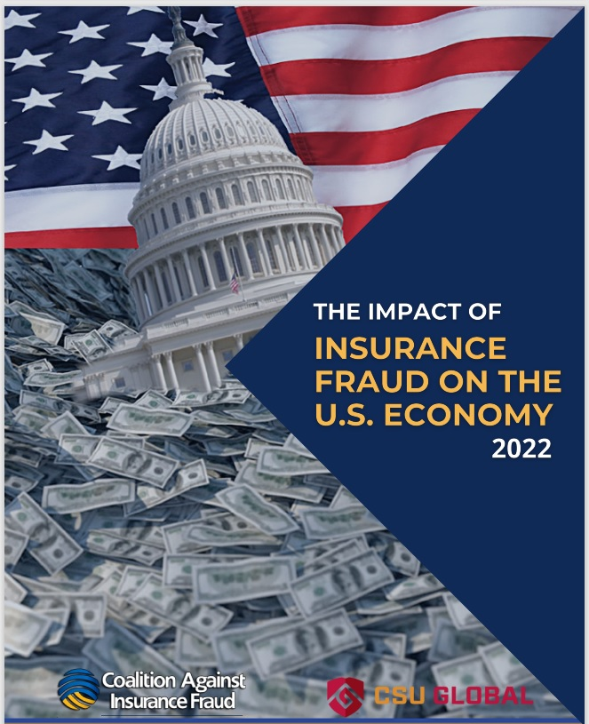
INSURANCE FRAUD STATS - NATIONWIDE

Slide 24
INSURANCE FRAUD STATS - NATIONWIDE
$308.6 Billion
Source: Coalition Against Insurance Fraud - 2022

Slide 25
IMPACT OF INSURANCE FRAUD
Insurance fraud is estimated to add as much as $1,000 to the cost of goods and services for each Virginian.

Slide 26
TYPES OF INSURANCE CLAIMS VSP CAN INVESTIGATE
Insurance as defined in VA Code Sections 38.2-110 through …122.2 and 38.2-124 through …132.
Fire Insurrection Explosion Glass
Natural Disaster Riot Boiler Personal Injury
Insects Civil War Machinery Property
Blights Epidemic Water Loss of Money
Disease Catastrophe Burglary Employee Liability
Animals Vandalism Theft Counterfeit
Electrical Disturbance Mischief Extortion Forgery
Elevators Strike Bribery Safe
Bombardment Lockout Threat Vault
Invasion Collapse Kidnapping Surety
Credit Against Debts Unemployment Motor Vehicle Aircraft
Precious Stone Marine Bridge Tunnel
Mortgage Guaranty Legal Service Home Protection Homeowners
Commercial Multi-Peril Farmowners Worker’s Compensation

Slide 27
TYPES OF INSURANCE CLAIMS VSP CANNOT INVESTIGATE
VA Code Section 52-36 – Definition of “Insurance Fraud” - Exclusions
Life Insurance
Title Insurance
Health Care Insurance

Slide 28
THIS ALSO MEANS THAT…
VA Code Section 52-36 – Definition of “Insurance Fraud” – Exclusions
… continued…
Life Insurance
Title Insurance
Health Insurance
These carriers do not pay into the Insurance Fraud Fund!
Notes:
The Virginia healthcare industry alone brought in approximately $83.5 billion in 2022. That means that IFP would receive an additional $41,750,000… more than 5x what we get now!

Slide 29
TYPES OF INSURANCE CLAIMS VSP
TYPICALLY INVESTIGATES
Property Fraud
Overstating the amount of damage to one’s home, car or other property.
Casualty Fraud
Faking or exaggerating an accident or injury to gain money from insurance providers.
Workers’ Compensation Fraud
Making claims about a work-related injury that either didn’t happen at all or occurred away from the workplace.

Slide 30
TYPES OF INSURANCE CLAIMS VSP
MAY NOT INVESTIGATE
Cell Phone Insurance Fraud
Example: The insured files a lost phone claim but continues to make/receive calls on that phone.
Without multiple occurrences it may not be worth the investigative effort.
Selling of Fake Insurance Policies by an Agent
Example: An insurance agent licensed in Virginia but not physically located in Virginia sells fake policies and pockets the premium money.
Often referred to the Bureau of Insurance; difficult to investigate as the suspect takes advantage of geography.
Inflated Repair Costs
Example: A body shop initially quotes $1,500 for a bumper repair, then increases that charge to $11,000 on the final bill.
The scope, quality, or quantity of work is difficult to prove.

Slide 31
TYPES OF INSURANCE CLAIMS VSP
WILL NOT INVESTIGATE
Rate Evasion
Example: An insured misrepresents the actual location where their vehicle is garaged.
Not a criminal offense.
Application Fraud
Example: A person fails to disclose a teenage driver on an application for insurance.
Not a criminal offense.
Submitted for Information Only
Example: An incomplete file or the synopsis says, “Submitted for informational purposes only.”
Opened and immediately declined by VSP which is a time-consuming process.

Slide 32
HOW DOES A CASE GET INVESTIGATED?
Insurance Carrier
StampOutFraud.com
VSP IFP
BCI Field Office
Special Agent

Slide 33
WHAT IS THE MINIMUM AMOUNT OF FRAUD THAT VSP WILL INVESTIGATE?
”Three a day keeps the Sergeant away.”
Notes:
Asking how much $$$ a fraud case has to involve before VSP will investigate is like asking how many tickets we have to write each day. While we don’t have a quota, the phrase “Three a day keeps the Sergeant away” is often true… so the higher the value of the referral the more likely it is to be investigated. Working speed enforcement is like fishing (and insurance fraud is no different)… everyone likes to catch the big fish.

Slide 34
WHAT WILL INCREASE THE CHANCE THAT VSP INVESTIGATES A CASE?
Ensure a direct connection to Virginia
Remember the venue of the act or the location where the suspect received money must be in Virginia
Include all elements of 18.2-178
Be sure to include the venue
Denote the dollar amount the suspect received or attempted to receive

Slide 35
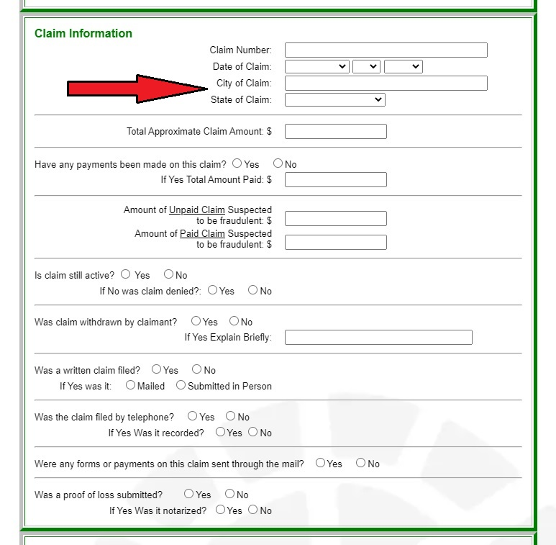
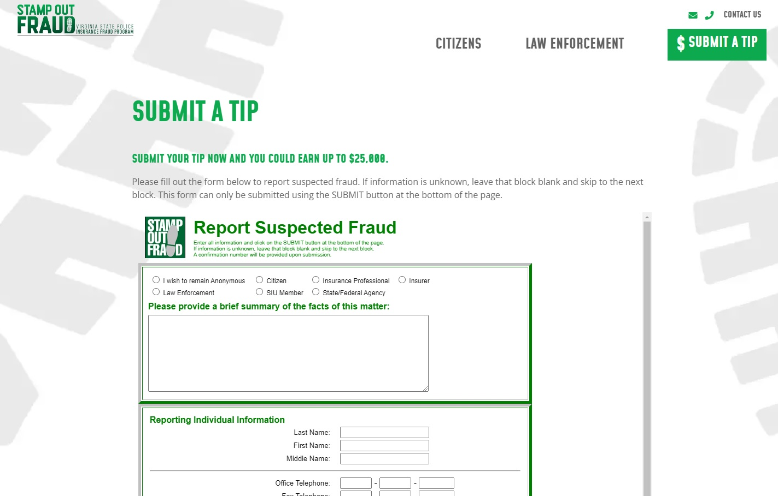
www.StampOutFraud.com

Slide 36
WHAT WILL INCREASE THE CHANCE THAT VSP INVESTIGATES A CASE? (cont.)
Brevity

Slide 37
WHAT WILL INCREASE THE CHANCE THAT VSP INVESTIGATES A CASE? (cont.)
Fewer Acronyms!
“555 I’m 10-7. 10-22. When I’m 10-8 I’ll be 10-17 to the 10-50 with 10-55. 10-21 215 and advise I’ll be 10-23 in 20.”

Slide 38
WHAT WILL INCREASE THE CHANCE THAT VSP INVESTIGATES A CASE? (cont.)
NI RS CD
FOL VSR NA
PR CV DOL
MMR MOU ULD
NIV PC TA
CH UW IGP
LL FNOL HO
UMB PMFS CSP
LI ILI AOR
CID EOR NYL

Slide 39
WHAT WILL INCREASE THE CHANCE THAT VSP INVESTIGATES A CASE? (cont.)
NI
NAMED INSURED? NORMALLY INSURED?
NATIONWIDE INSURANCE? NUMBER IF?
NOMINALLY INSURED? NATIONAL INSURANCE?
NET INCOME? NOT INSURED?

Slide 40
WHAT WILL INCREASE THE CHANCE THAT VSP INVESTIGATES A CASE? (cont.)
VA
Virginia?
United States Department of Veterans’ Affairs?

Slide 41
WHAT WILL INCREASE THE CHANCE THAT VSP INVESTIGATES A CASE? (cont.)
AVOID THE GENERIC
Email Addresses
Phone Numbers

Slide 42

HOW DOES VSP SHARE INFORMATION?
This is a requirement from the Virginia Information Technologies Agency (VITA).

Slide 43
BEFORE VSP CAN PURSUE CHARGES…
Our special agents are required to consult with a Commonwealth’s Attorney.

Slide 44
SPECIAL PROSECUTORS
City of Richmond
City of Norfolk
City of Salem
Arlington County

Slide 45

PUBLIC PERCEPTION

Slide 46
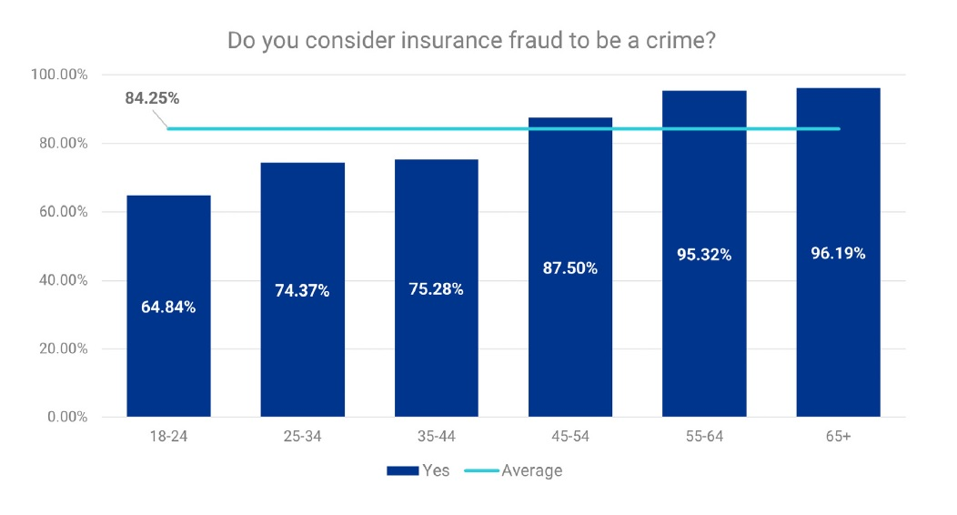
PUBLIC PERCEPTION (cont.)
Source: Coalition Against Insurance Fraud - 2023

Slide 47
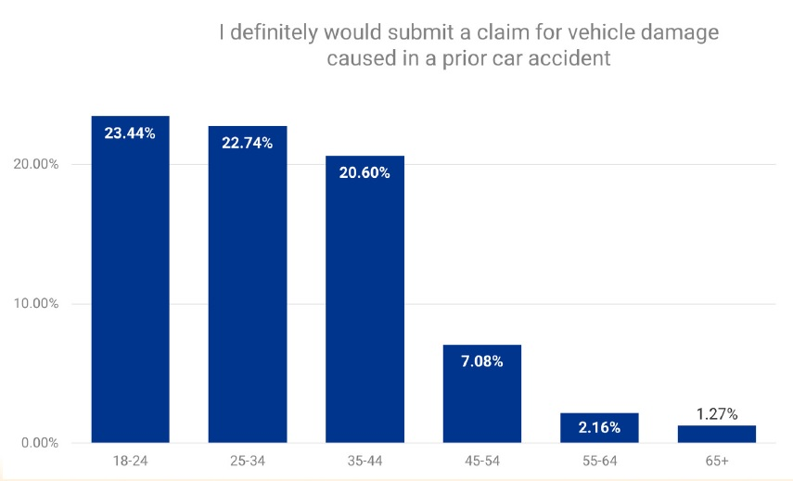
PUBLIC PERCEPTION (cont.)
Source: Coalition Against Insurance Fraud - 2023

Slide 48
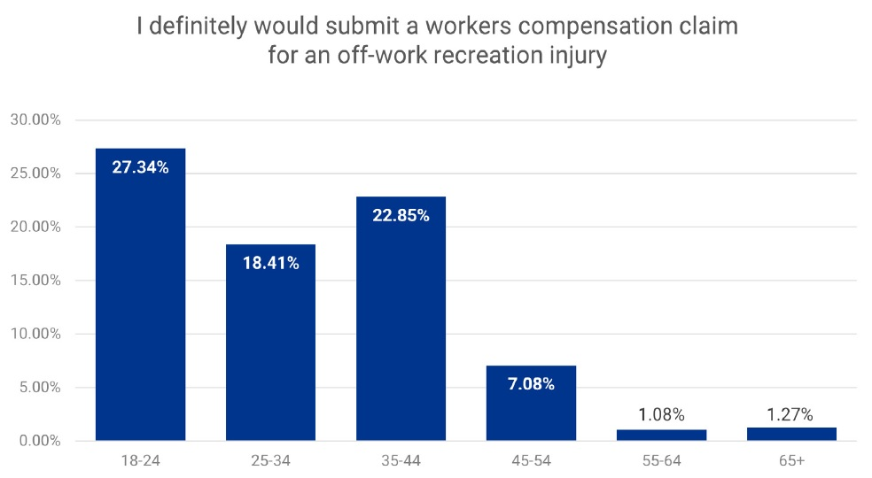
PUBLIC PERCEPTION (cont.)
Source: Coalition Against Insurance Fraud - 2023

Slide 49
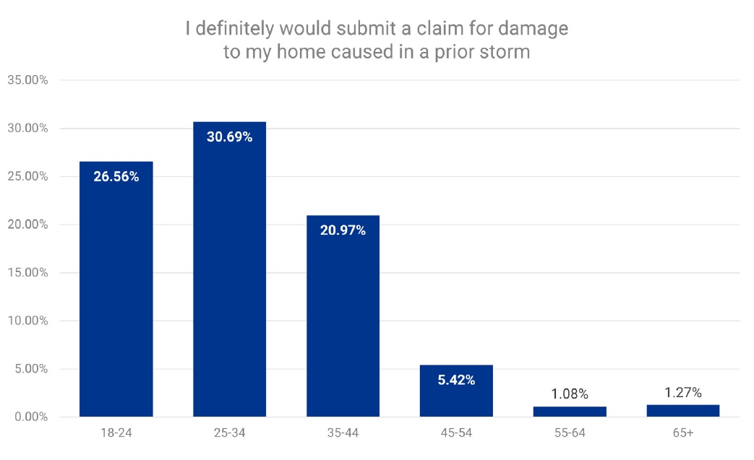
PUBLIC PERCEPTION (cont.)
Source: Coalition Against Insurance Fraud - 2023

Slide 50
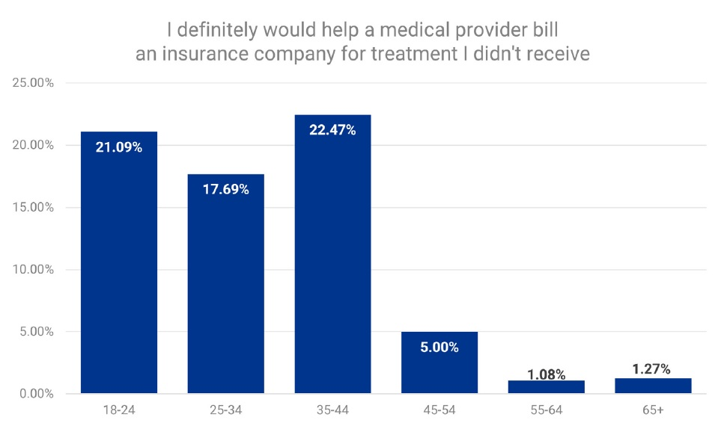
PUBLIC PERCEPTION (cont.)
Source: Coalition Against Insurance Fraud - 2023

Slide 51
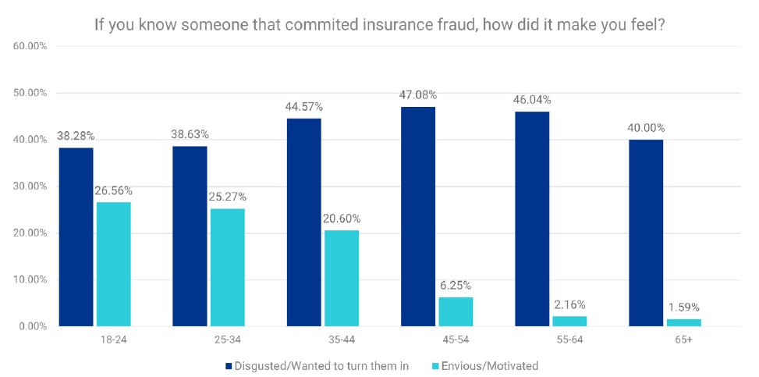
PUBLIC PERCEPTION (cont.)
Source: Coalition Against Insurance Fraud - 2023

Slide 52
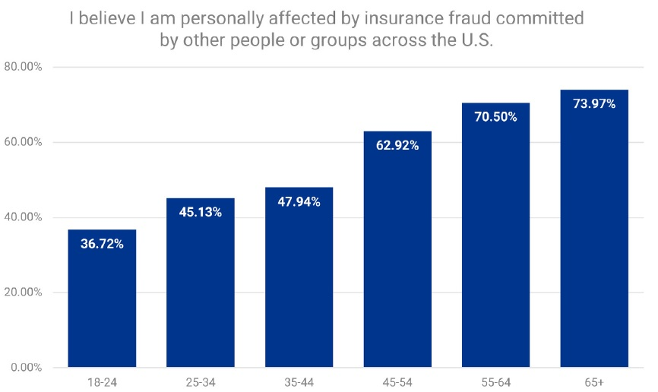
PUBLIC PERCEPTION (cont.)
Source: Coalition Against Insurance Fraud - 2023

Slide 53


BUILDING PUBLIC AWARENESS
12+
2023 IFP Advertising Campaign
MILLON
ADVERTISING IMPRESSIONS

Slide 54
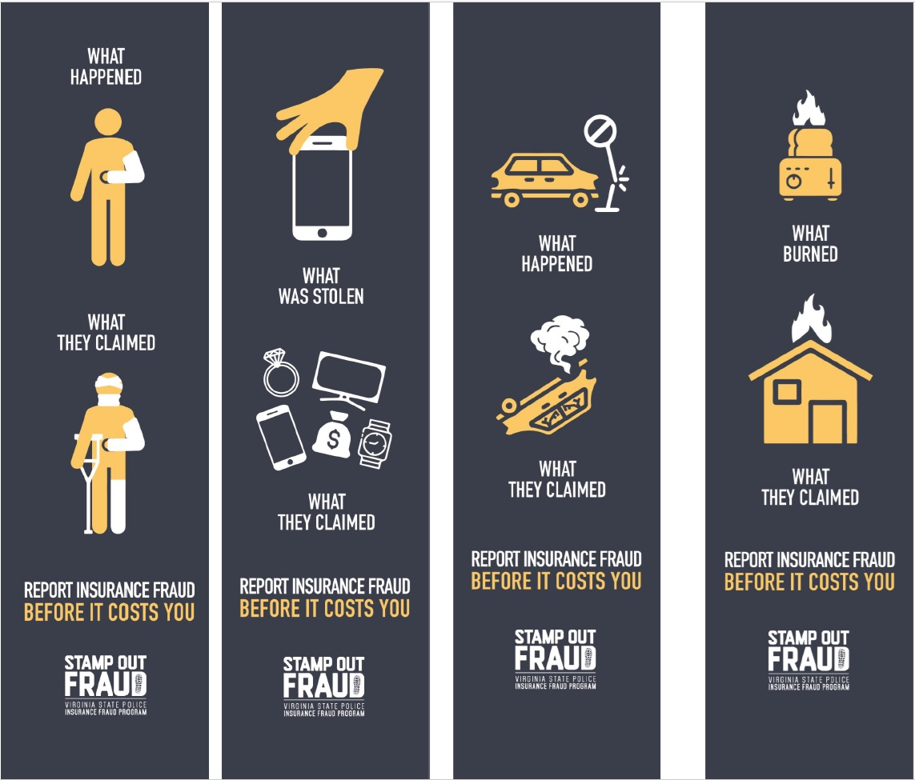
BUILDING PUBLIC AWARENESS
2025 IFP
Advertising
Campaign
TheCostofFraud.com

Slide 55
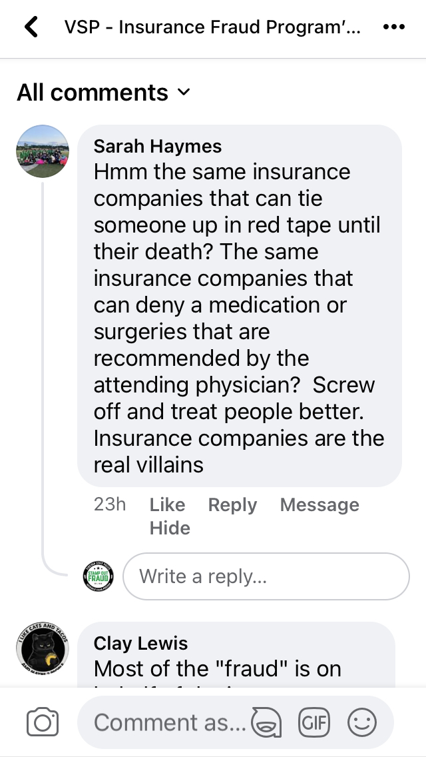
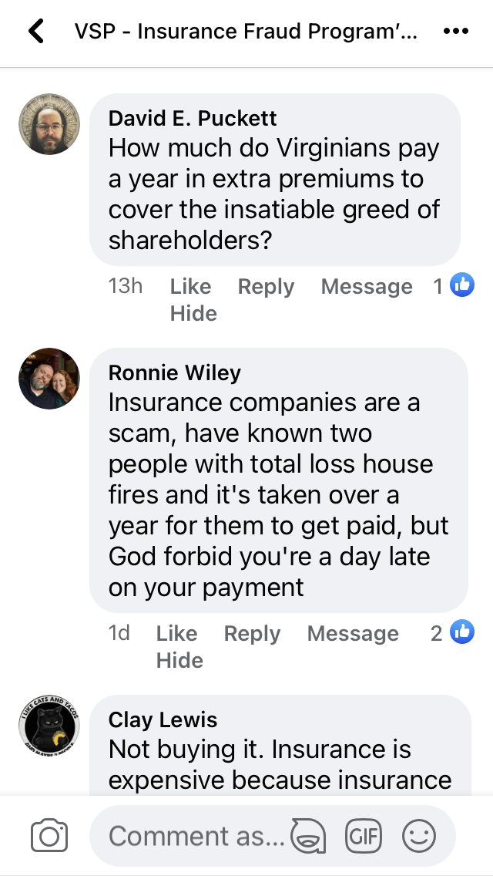
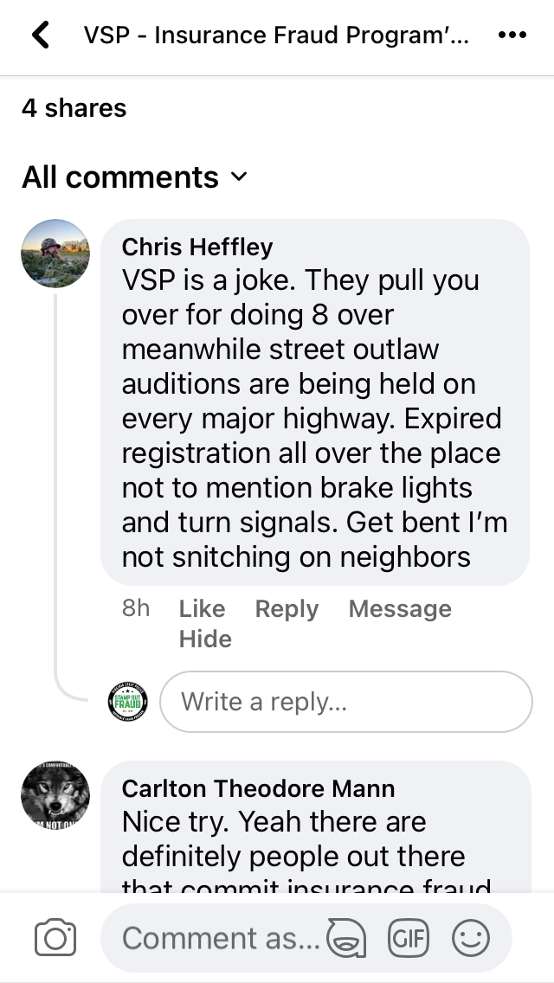
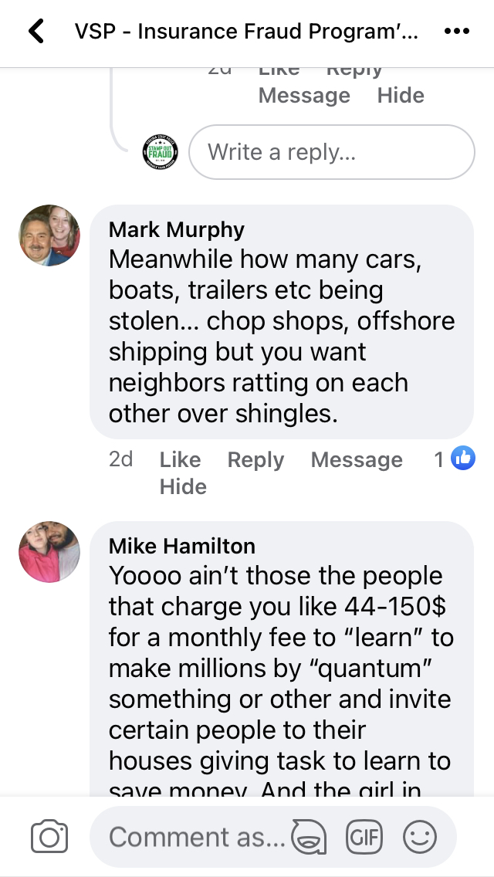
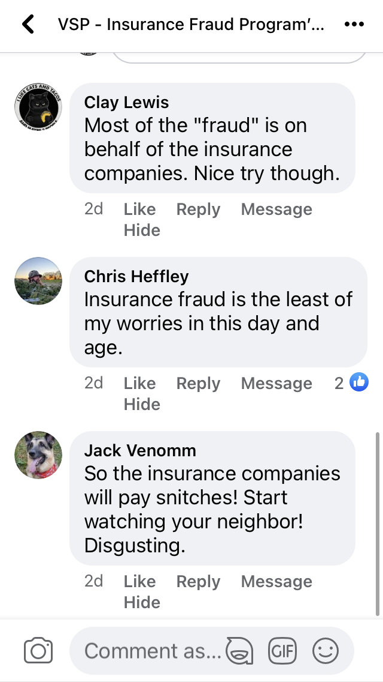
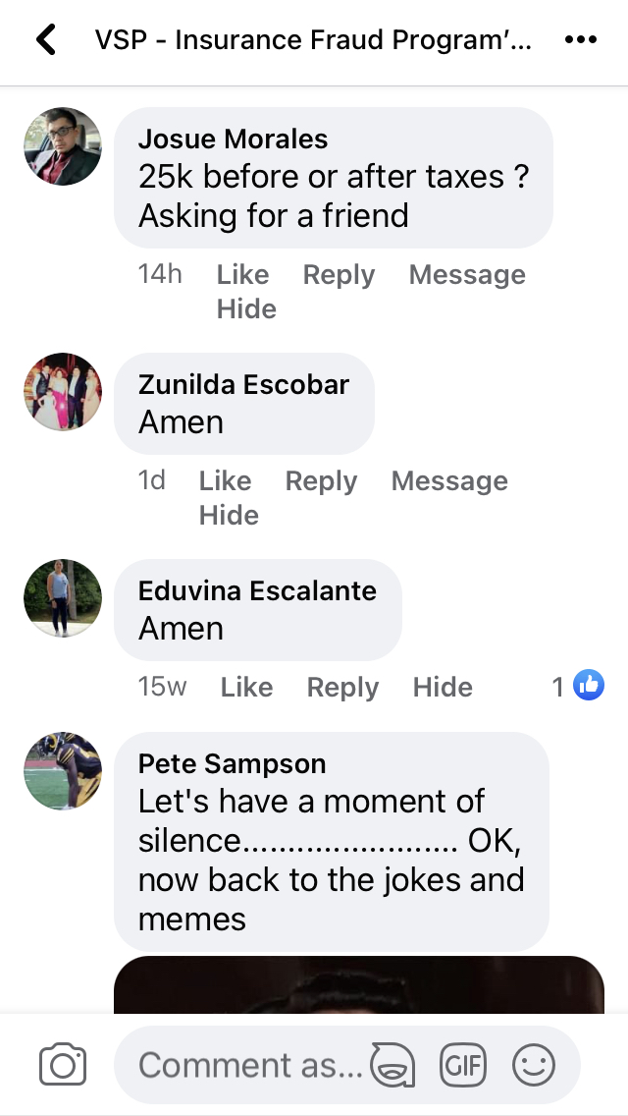
OVERCOMING THE APATHY

Slide 56
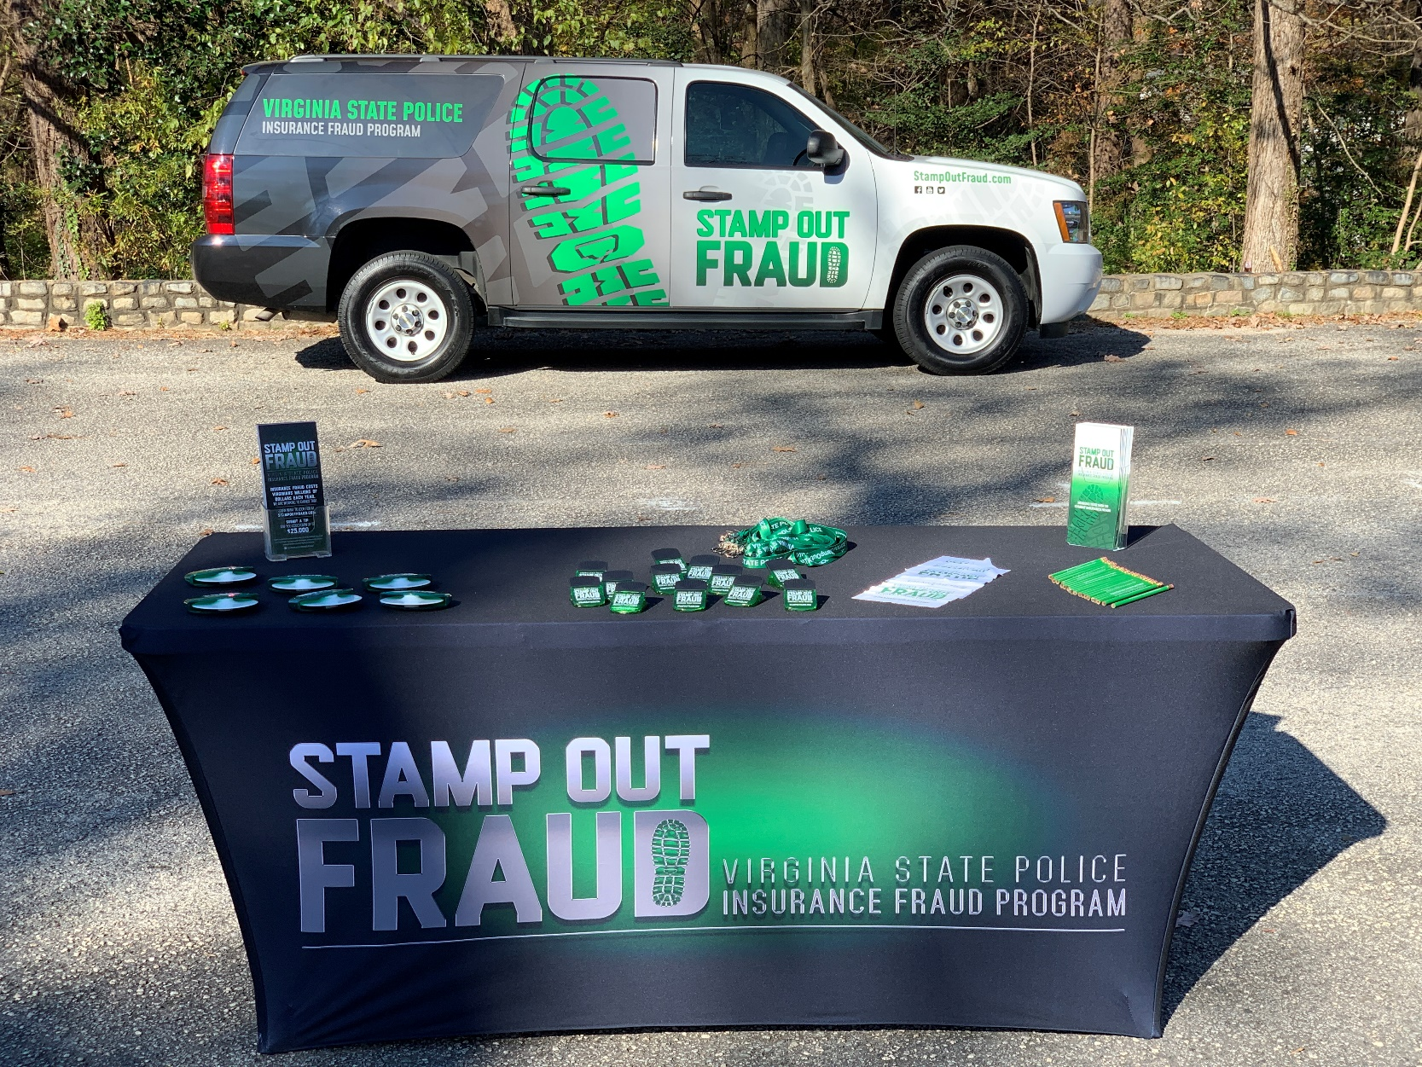
WHAT IS VSP DOING ABOUT IT?

Slide 57
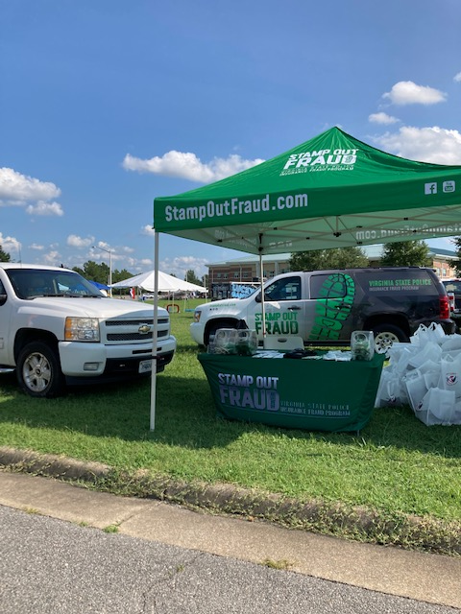
INVESTIGATIONS
Special Agents initiated
335 investigations
in 2024

Slide 58
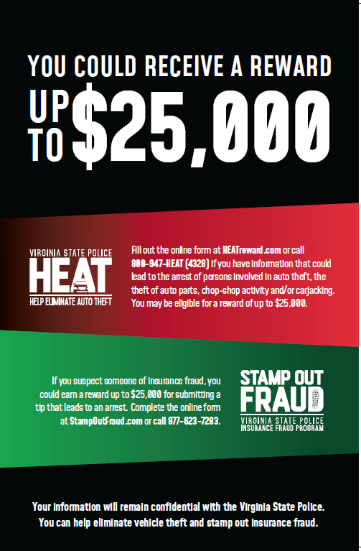


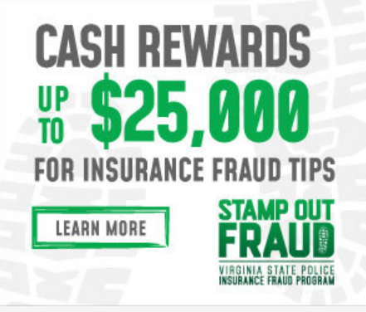
REWARDS FOR TIPS
VA Code Section 52-42
VSP Web Banner
Banner Ads
Posters

Slide 59
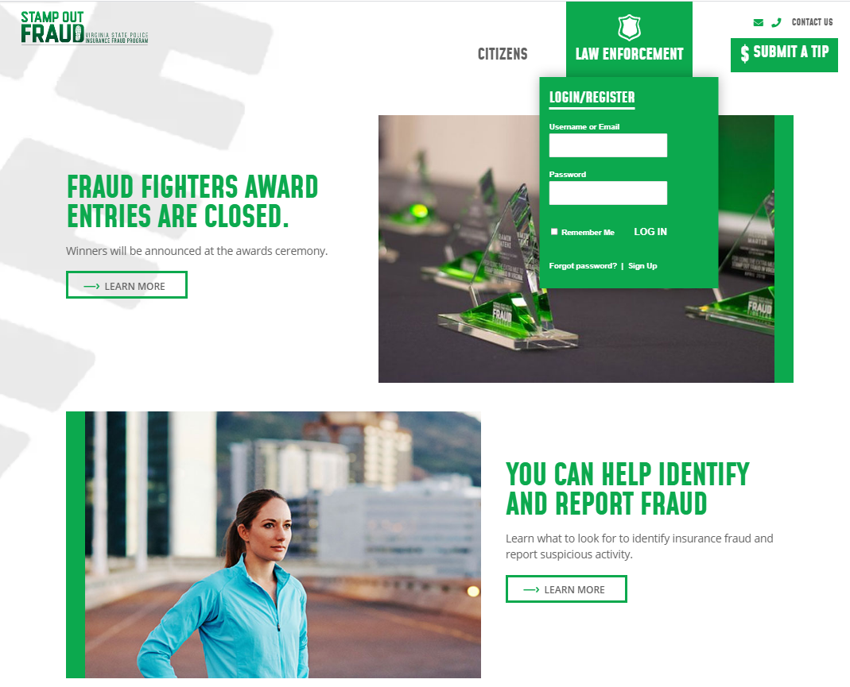
WEBSITE
StampOutFraud.com
Educational information for citizens
Law enforcement restricted area
News and event
Insurance fraud quiz
Annual reports
Submit a tip for a reward
www.StampOutFraud.com

Slide 60
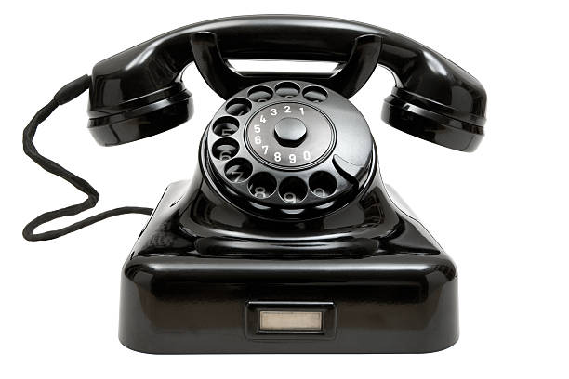
HOTLINE
1-877-62-FRAUD
Answered Mon – Fri
8:00 a.m. - 4:30 p.m.

Slide 61

FRAUD FIGHTER AWARDS
Since 2005

Slide 62
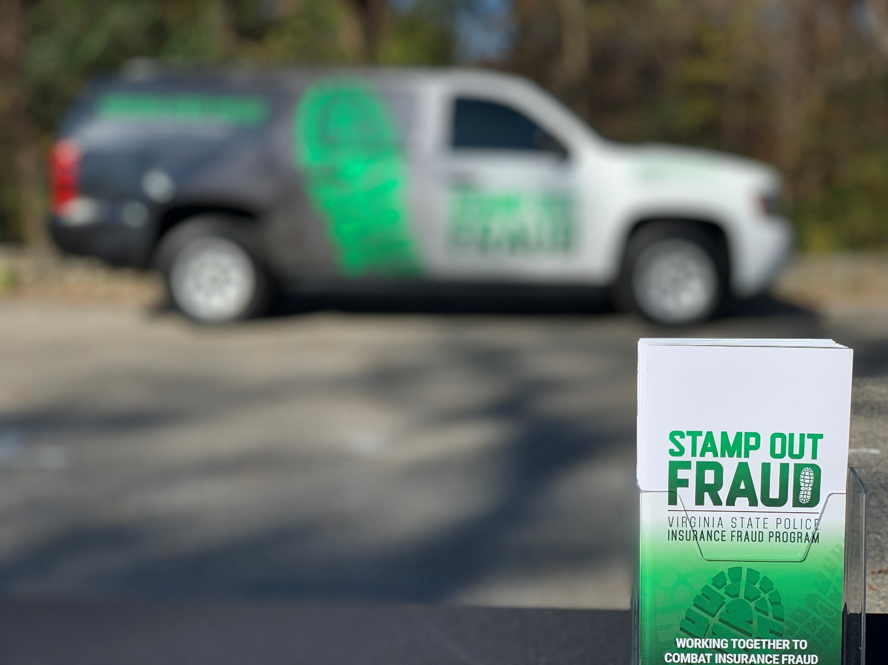
TRAINING AND EDUCATION
$365,000

Slide 63
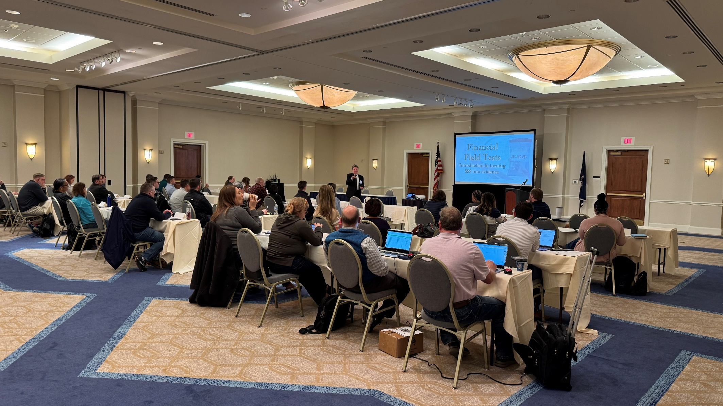
“RED FLAG” CONFERENCE
Since 2009
Notes:
2025 – “Money Talks” in Staunton and Red Flag

Slide 64
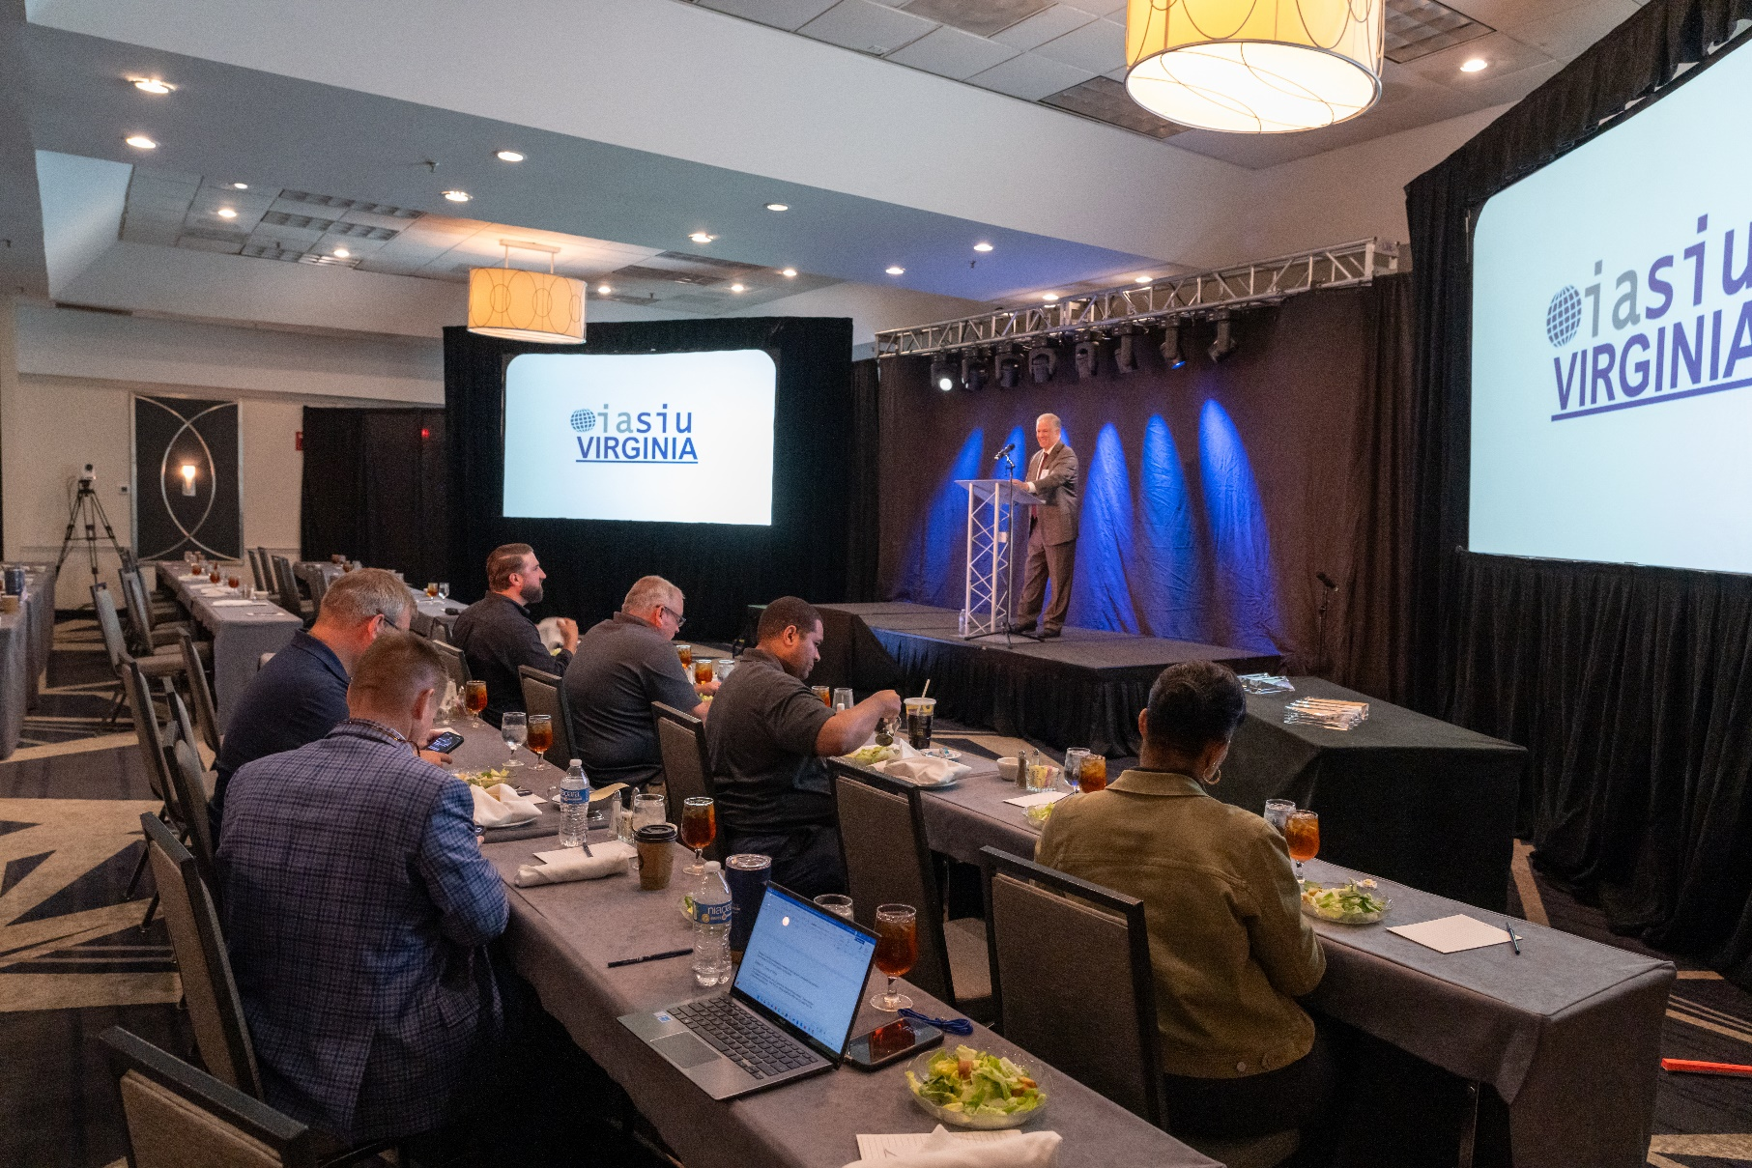
VAIASIU ANNUAL SEMINAR
Since 2014

Slide 65
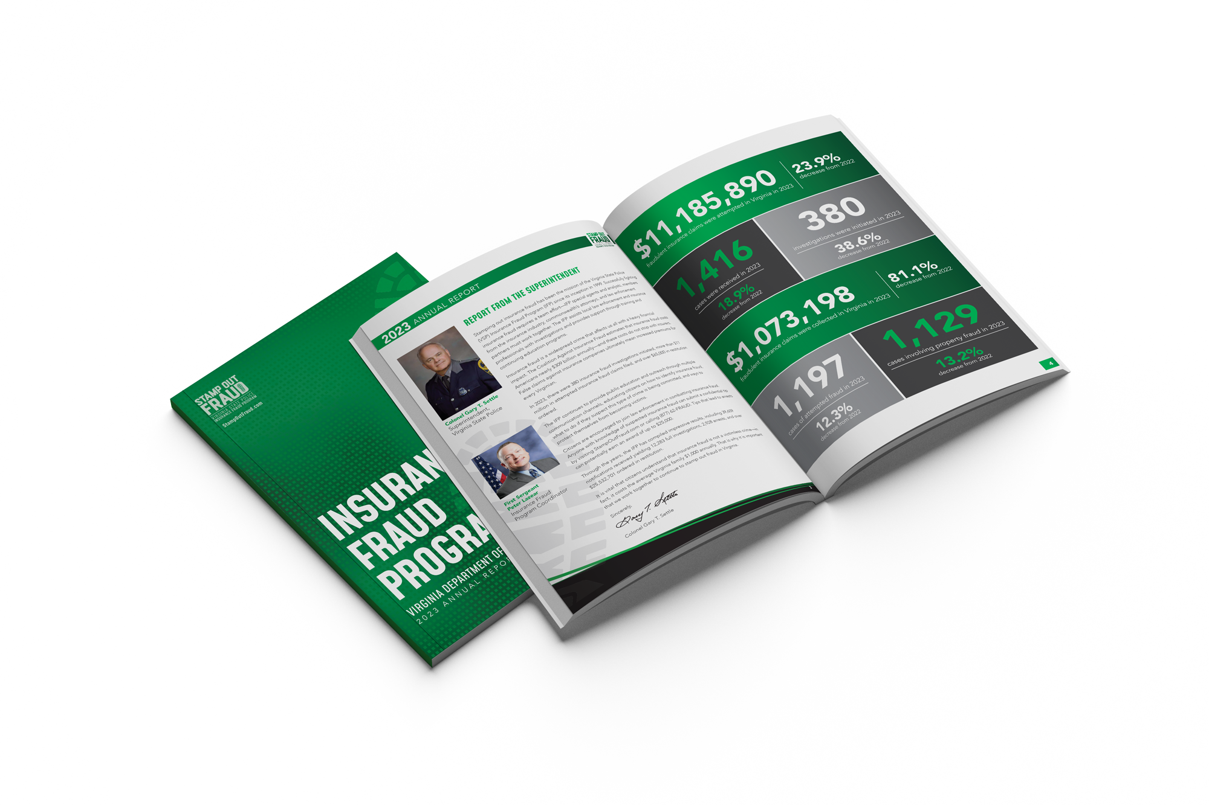
ANNUAL REPORT
Due February 15th
VA Code Section 52-43
StampOutFraud.com
Public Awareness

Slide 66

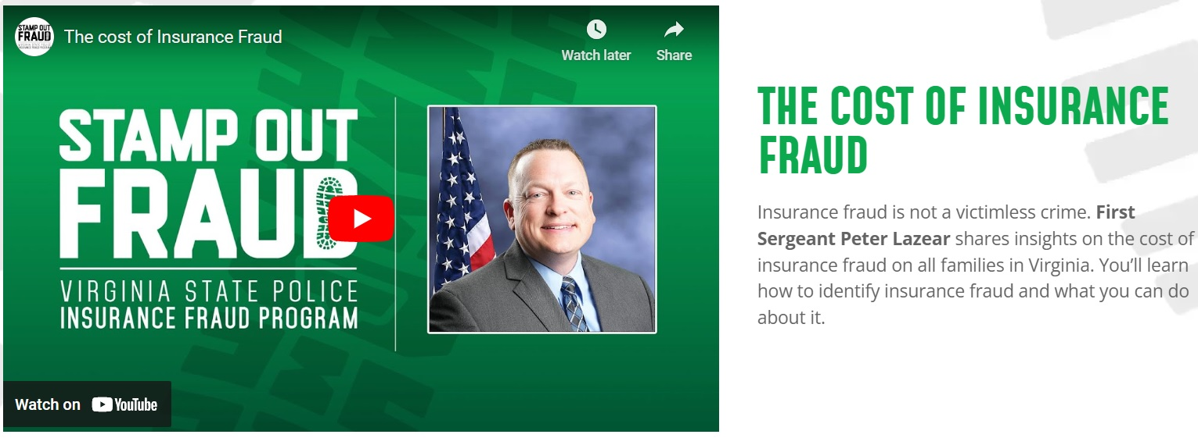
RADIO INTERVIEWS

Slide 67
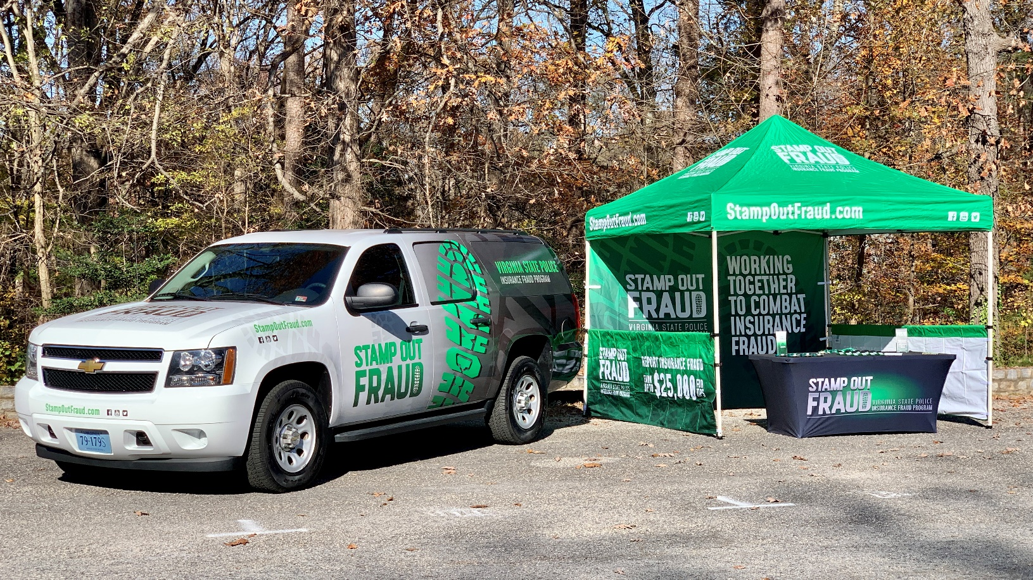
PUBLIC OUTREACH

Slide 68

PARTNERING WITH THE SCC
Bureau of Insurance
Licensing
Regulatory Control
Public Adjusters

Slide 69
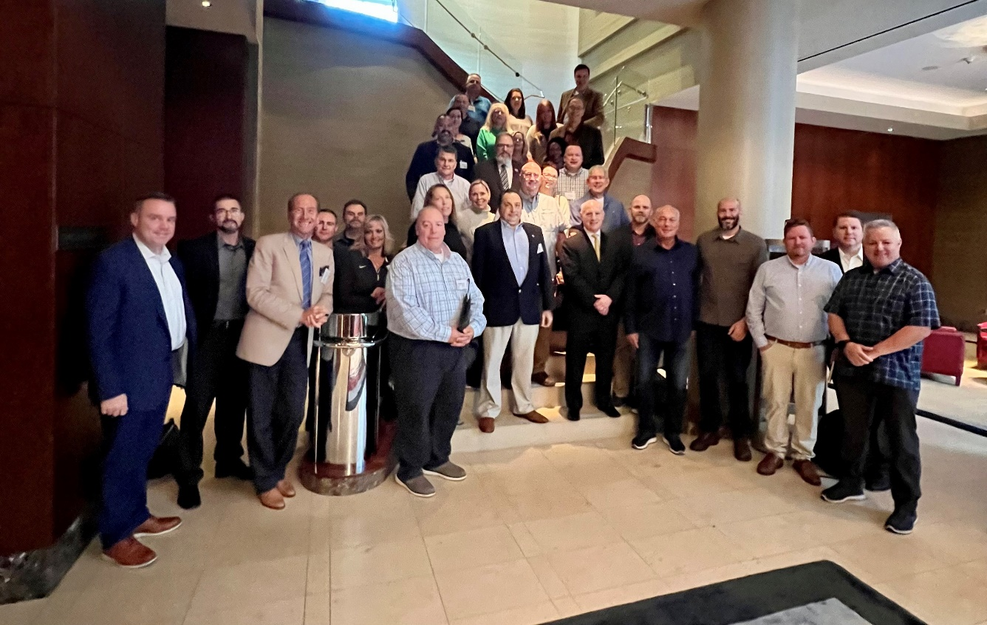
NATIONAL FRAUD DIRECTORS’ CONFERENCE
2022 – Boston, MA
2023 – St. George, UT
2024 – Pittsburgh, PA
2025 – Savannah, GA
2026 – New Orleans, LA

Slide 70

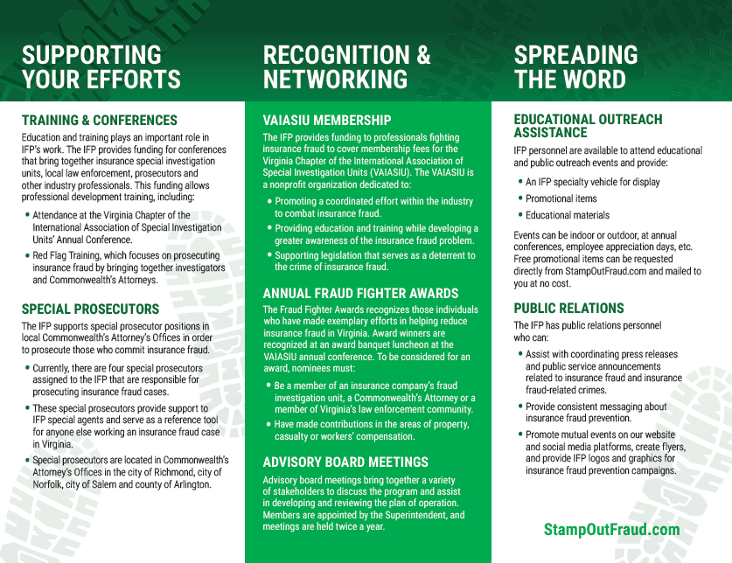
REACHING LAW ENFORCEMENT

Slide 71
CONCLUSION – INSURANCE FRAUD
IS NOT …
Easy to investigate
Easy to prosecute
A victimless crime

Slide 72
CONCLUSION – INSURANCE FRAUD
IS …
Becoming more prevalent
Costing citizens
Being investigated by VSP
A chance for us to collaborate.

Slide 73
1-877-62-FRAUD (3-7283)
StampOutFraud.com
First Sergeant Peter W. Lazear
peter.lazear@vsp.virginia.gov
(804) 221-0997

