Slide 1
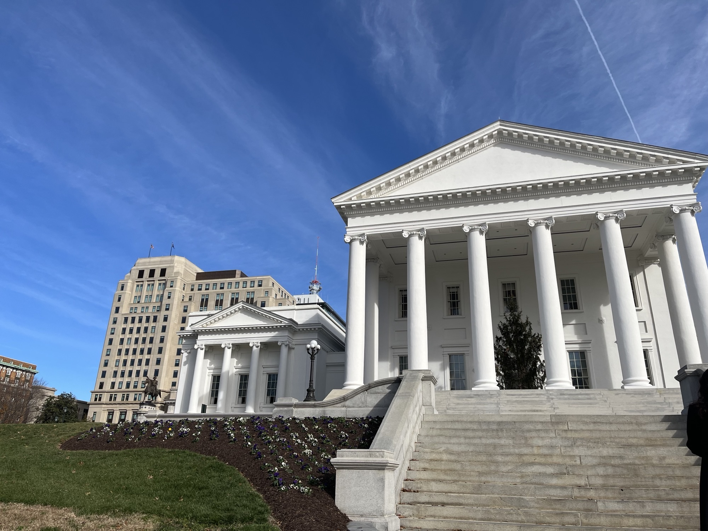

IIAV Legislative Update
2025 Session

Slide 2
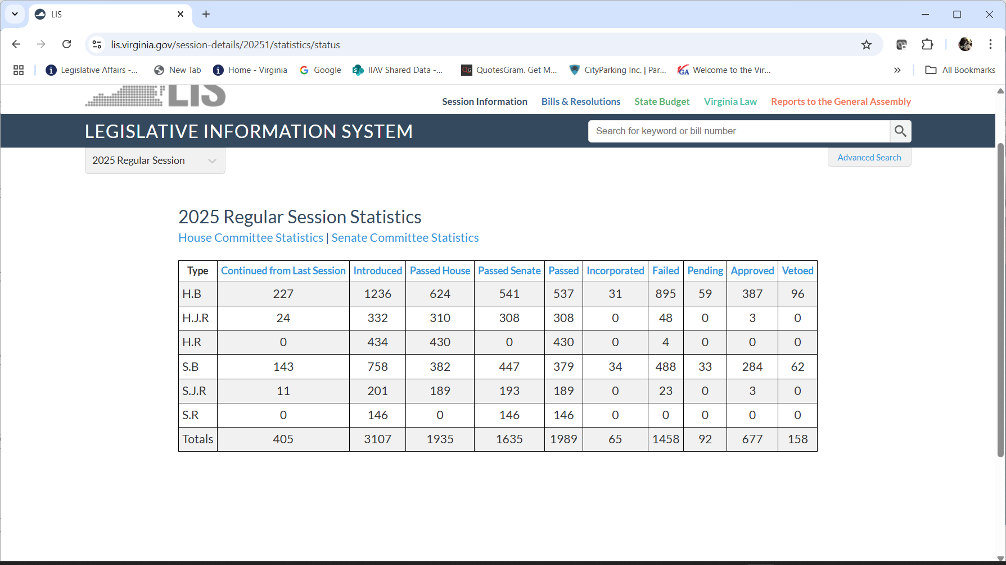
2025 Session
A “Short” Session
April 9, 2025

Slide 3
2025 Session
Legislation specifically related to insurance agents:
HB 1778 Insurance agents; appointments and terminations.
Status: Signed by Governor
Introduced by: Richard C. "Rip" Sullivan, Jr. (Chief Patron)
BOI bill with technical amendments
Notes:
The BOI removes outdated agent appointment processes from the Code to allow the BOI to utilize processes more efficient for the Bureau and the industry. Secondly, the proposal removes the $50/day penalty for the late payment of appointment fees – instead late payments will be addressed according to Section 38.2-2-218 or 1831 – fine or penalties.

Slide 4
2025 Session
Legislation related to agency/business operations
SB 1132 Prospective employees; prohibiting employer seeking wage or salary history. Status: VETOED
Introduced by: Jennifer B. Boysko
HB 2531 Paid family and medical leave insurance program; definitions, notice requirements, civil action.
Status: VETOED Introduced by: Briana D. Sewell (Chief Patron)

Slide 5
2025 Session
SB 1218 Labor and employment; covenants not to compete prohibited, low-wage employees, exceptions, civil penalty
Status: Signed by Governor
Introduced by: Richard H. Stuart (Chief Patron)
Notes:
The Federal Fair Labor Standards act provides an exemption from both minimum wage and overtime pay for employees employed as bona fide executive, administrative, professional and outside sales employees – also exempt are certain computer employees.
Essentially doesn’t apply to Exempt employees.

Slide 6
2025 Session
HB2060Workers' compensation benefits; post-traumatic stress disorder incurred by firefighters, etc.
Print
Status: Failed
Patrons
All Patrons
Introduced by: Paul E. Krizek
Workers Compensation Bills
Presumption Bills
HB 1933/ SB 920 Workers' compensation; presumption as to death or disability from throat cancer. [Firefighters] Status: Signed by Governor Introduced by: Destiny LeVere Bolling / Saddam Azlan Salim
HB 2060 Workers' compensation benefits; post-traumatic stress disorder incurred by firefighters, etc. Status: Failed Introduced by: Paul E. Krizek

Slide 7
2025 Session
HB 1851 Workers' compensation; presumption for certain cancers, sheriffs and deputy sheriffs. Status: Failed Introduced by: Jonathan "Jed" Arnold
HB 2320 Workers' compensation; presumption of compensability for lymphoma or myeloma. [fire fighters, etc.] Status: Failed Introduced by: Will Davis

Slide 8
2025 Session
Workers Compensation – Repetitive Motion Bills
SB 803/788/1112/HB2481 Workers' compensation; injuries caused by repetitive and sustained physical stressors. Status: Failed, Failed, Failed, Failed Introduced by: Senators McDougle, Head, Williams Graves and Delegate Krizek

Slide 9
2025 Session
Workers Compensation – sort of….
SB 1299 Workers' compensation; compensation to dependents or beneficiaries of an employee killed. Status: Failed Introduced by: Jeremy S. McPike

Slide 10
2025 Session
Flood – Virginia “Buyer’s Beware” Law
HB 2348 Virginia Residential Property Disclosure Act; flood-related disclosures. Status: Failed Introduced by: Phil M. Hernandez
Video

Slide 11
2025 Session
Life Insurance
HB 2769 Life or health insurances; unfair discrimination, pre-exposure prophylaxis for prevention of HIV. Status: VETOED
Introduced by: Jeion A. Ward
Notes:
ACLI companies say that the don’t do this. Didn’t care if it passed or not.
Medication to prevent HIV.

Slide 12
2025 Session
Health Insurance – Mandates
HB 1609 Essential health benefits benchmark plan; Commission to consider coverage for infertility treatment. Status: Awaiting Governor's Action – Introduced by: Dan I. Helmer
Notes:
Correction – has not passed – Governor can veto or sign or allow to pass with out signature.
Has until May 3 to take action.

Slide 13
2025 Session
FAILED…but
sent to HIRC
HB 1633 Health insurance; coverage for speech therapy as a treatment for stuttering.
HB 1670 Health insurance; cost-sharing for epinephrine injectors.
SB 954 Fertility preservation treatments; state plan for medical assistance services.
SB 1168 Health insurance; coverage for acupuncture treatments.
SB 1186 Health insurance; coverage for donor human milk, penalty.

Slide 14
2025 Session
SB 1447 Health insurance; coverage for at-home blood pressure monitors, report. Status: Failed - PBI Introduced by: Stella G. Pekarsky
HB 1828 Health insurance; cost sharing for breast examinations.
Status: Signed by Governor Introduced by: Shelly A. Simonds
HB 2371 Health insurance; coverage for contraceptive drugs and devices. Status: Awaiting Governor's Action Introduced by: Candi Mundon King

Slide 15
2025 Session
HB 1641 State plan for medical assistance services and health insurance; pediatric autoimmune neuropsychiatric disorders associated with streptococcal infections and pediatric acute-onset neuropsychiatric syndrome. Status: Signed by Governor
Introduced by: Patrick A. Hope
HB1639Health insurance; tobacco surcharge, removes sunset.
Status: VETOED
Introduced by: Patrick A. Hope

Slide 16
2025 Session
HB 2372 Health Care, Joint Commission on; duty to study proposed health insurance mandates. Status: Signed by Governor Introduced by: Mark D. Sickles
SB 774 Essential health benefits benchmark plan review; members of stakeholder work group. Status: Signed by Governor
Introduced by: Scott A. Surovell

Slide 17
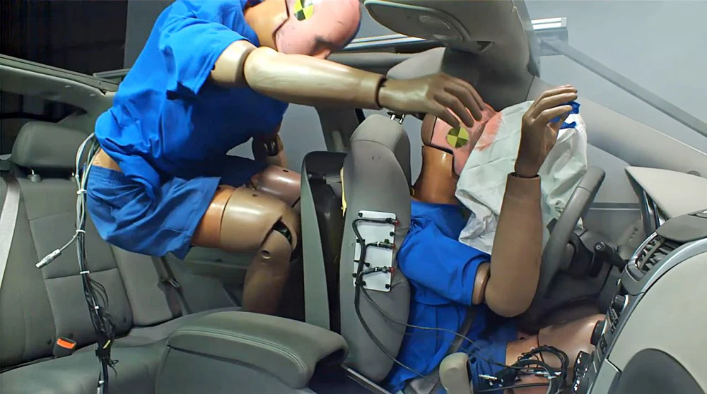
2025 Session
Safety:
HB 2475 Motor vehicles; use of safety belt systems. Status: Signed by Governor Introduced by: Karen Keys-Gamarra
Notes:
A significant percentage of injuries in rear seats are associated with not wearing a seat belt. While data varies, it's estimated that nearly 60% of back seat passengers killed in crashes were unbuckled. This indicates that a substantial number of rear seat occupants are not wearing safety belts when they're injured in accidents.

Slide 18
2025 Session
VIDEO
Property/Casualty Legislation:
SB 904 Medical malpractice; limitation on recovery; certain actions. Status: Failed Introduced by: William M. Stanley, Jr.
HB2069Insurance; additional purposes for Fire Programs Fund Aid to Localities Grant Program established. Status: Failed
Introduced by: Thomas A. Garrett, Jr.

Slide 19
2025 Session
SB 1159 Motor vehicle insurance; underinsured motorist coverage, revises language of required notice. Status: Signed by Governor Introduced by: Mark D. Obenshain
HB1682Surplus lines broker taxes; certain insurance policies.
Status: Signed by Governor Introduced by: Laura Jane Cohen
Notes:
SB 1159 – Introduced at the request of the BOI – The bill updates outdated language inf the notice provided to insureds regarding underinsured motorist coverage options. 2022 legislation requires insurers to provide the notice specificized in in 38.2-2202 to insureds, informing them that they may reduce their coverage if they have not already done so.
You are entitled to purchase uninsured/underinsured coverage limits equal to the liability limits on your motor vehicle policy. However, any one named insured has the right to reduce the limits of the uninsured/underinsured motorist coverage to less than the liability limits on the policy but no lower than the financial responsibility limits required by § 46.2-472 of the Code of Virginia. The insurer may require that a request to reduce coverage be in writing. Once any one named insured reduces the policy limits for uninsured/underinsured motorist coverage below the policy's liability limits, that election is binding on all insureds on the policy. Later, if you desire to increase your limits, you must make a specific request to your insurer. You may want to put this request in writing.

Slide 20
2025 Session
HB 2000 Dam Safety Act; powers and duties of DCR, rights and requirements of dam owners, civil penalty. Status: Signed by Governor Introduced by: Amy J. Laufer
HB 1628 Fire insurance; assignment of claims prohibited.
Status: Signed by Governor Introduced by: Karen Keys-Gamarra
Notes:
HB2000 and SB857:
Are these administration/DCR bills? If so, what are the reasons for the bills?
Yes. Bill would reduce Dam Safety grant match, reduce requirements for many low hazard dams (e.g. fewer inspections by an engineer), and streamline enforcement procedure when dams fail
Looks like the grant match for dam owners would be reduced from 50% to 30% which would be a positive for us. Yes
Authorizes localities to take action on dams with imminent danger. Did localities request this? Have received this request in some instances. Will mainly involve closing roads and assisting with lowering water levels in cases where dam failure is imminent.
Adds in a civil penalty for not submitting a plan to address deficiencies in a dam with no imminent danger within 30 days(!) of the safety inspection. And, imposes a civil penalty for not doing so. Seems like a very short period of time, particularly for private dams owned by multiple parties and subject to an engineer’s availability. Has there been an issue with dam owners not complying with the “reasonable time” frame currently in code? We have found that most owners of registered dams have a relationship with an engineer. For those that do not, we already allow more time to obtain an engineer. This proposal is for those dam owners, and there have been quite a few, that ignore the Department’s efforts to work with them to resolve deficiencies. We currently have more than one such dam that needs repairs but the owners are not cooperating.
We had two separate stakeholder groups review current code and regulations that made recommendations. These bills represent those recommendations.
SB 1154 Prohibits a fire insurance policy or a fire insurance policy in combination with other coverages from assigning or otherwise transferring, in whole or in part, to any other person the duties, rights, or benefits of the insured under the policy arising from a claim or covered loss without written consent of the insurer. Any such contract provision is void and unenforceable under the bill. This bill is identical to HB 1628.

Slide 21

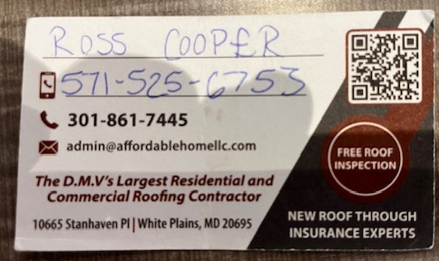
2025 Session

Slide 22
2025 Session
HB 2205 Vehicle owners; proof of financial responsibility in the future. Status: Signed by Governor Introduced by: Terry G. Kilgore
SB 1152 Nursing homes and certified nursing facilities; professional liability insurance, proof of coverage. Status: Signed by Governor Introduced by: Mark D. Obenshain
Notes:
§ 46.2-439. Proof of financial responsibility in the future. Proof of financial responsibility, when requested, in the future shall be made by filing with the Commissioner the written certificate of any insurance carrier authorized to do business in the Commonwealth, certifying that there is in effect a motor vehicle liability policy for the benefit of the person required to furnish proof of financial responsibility. This in the future. Such certificate shall be an American Association of Motor Vehicle Administrators Uniform Financial Responsibility Form (SR-22), or Virginia Uniform Financial Responsibility Form (FR-44), depending on the circumstances. Such certificate shall give its effective date and the effective date of the policy and shall be submitted in a form prescribed by the Commissioner.

Slide 23
2025 Session
What do these two bills have in common????
SB 1012 Motor vehicle collisions; collection of certain mobile telephone data, collision reports. Status: Failed Introduced by: Scott A. Surovell
HB 2256 Motor vehicle accident; increases damage threshold.
Status: Signed by Governor Introduced by: Michelle Lopes Maldonado
VIDEO
Notes:
HB: 2256: Increases from $1,500 to $3,000 the property damage threshold at which law enforcement is required to forward a written report of a motor vehicle accident to the Department of Motor Vehicles.

Slide 24
2025 Session
Your turn….how would you vote?
HB 2095 Fraudulent insurance acts; penalty. Status: Failed
Introduced by: Scott A. Wyatt

Slide 25
2025 Session
Code of Virginia
§ 1-201. Acts of Parliament.
The right and benefit of all writs, remedial and judicial, given by any statute or act of Parliament, made in aid of the common law prior to the fourth year of the reign of James the First, of a general nature, not local to England, shall still be saved, insofar as the same are consistent with the Bill of Rights and Constitution of this Commonwealth and the Acts of Assembly.

Slide 26


She Took Out 40 Insurance Policies Worth $20 Million, Scamming Insurers and Investors
March 13, 2025
A federal jury convicted a Maryland woman yesterday for conspiracy to commit insurance fraud and related charges for wire fraud, money laundering and filing false tax returns.

Slide 27
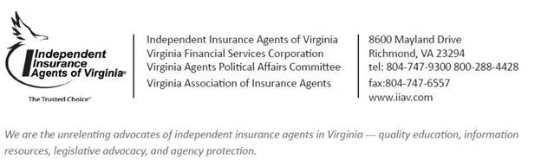
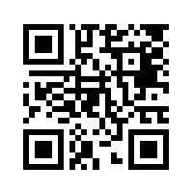
I
IIAV Update on the Virginia General Assembly

